Slide 1
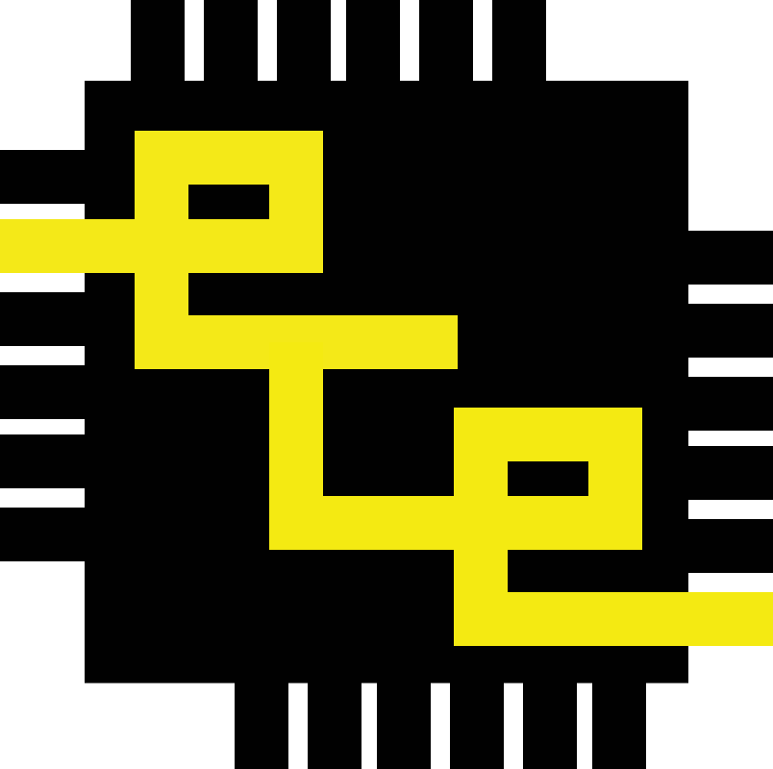


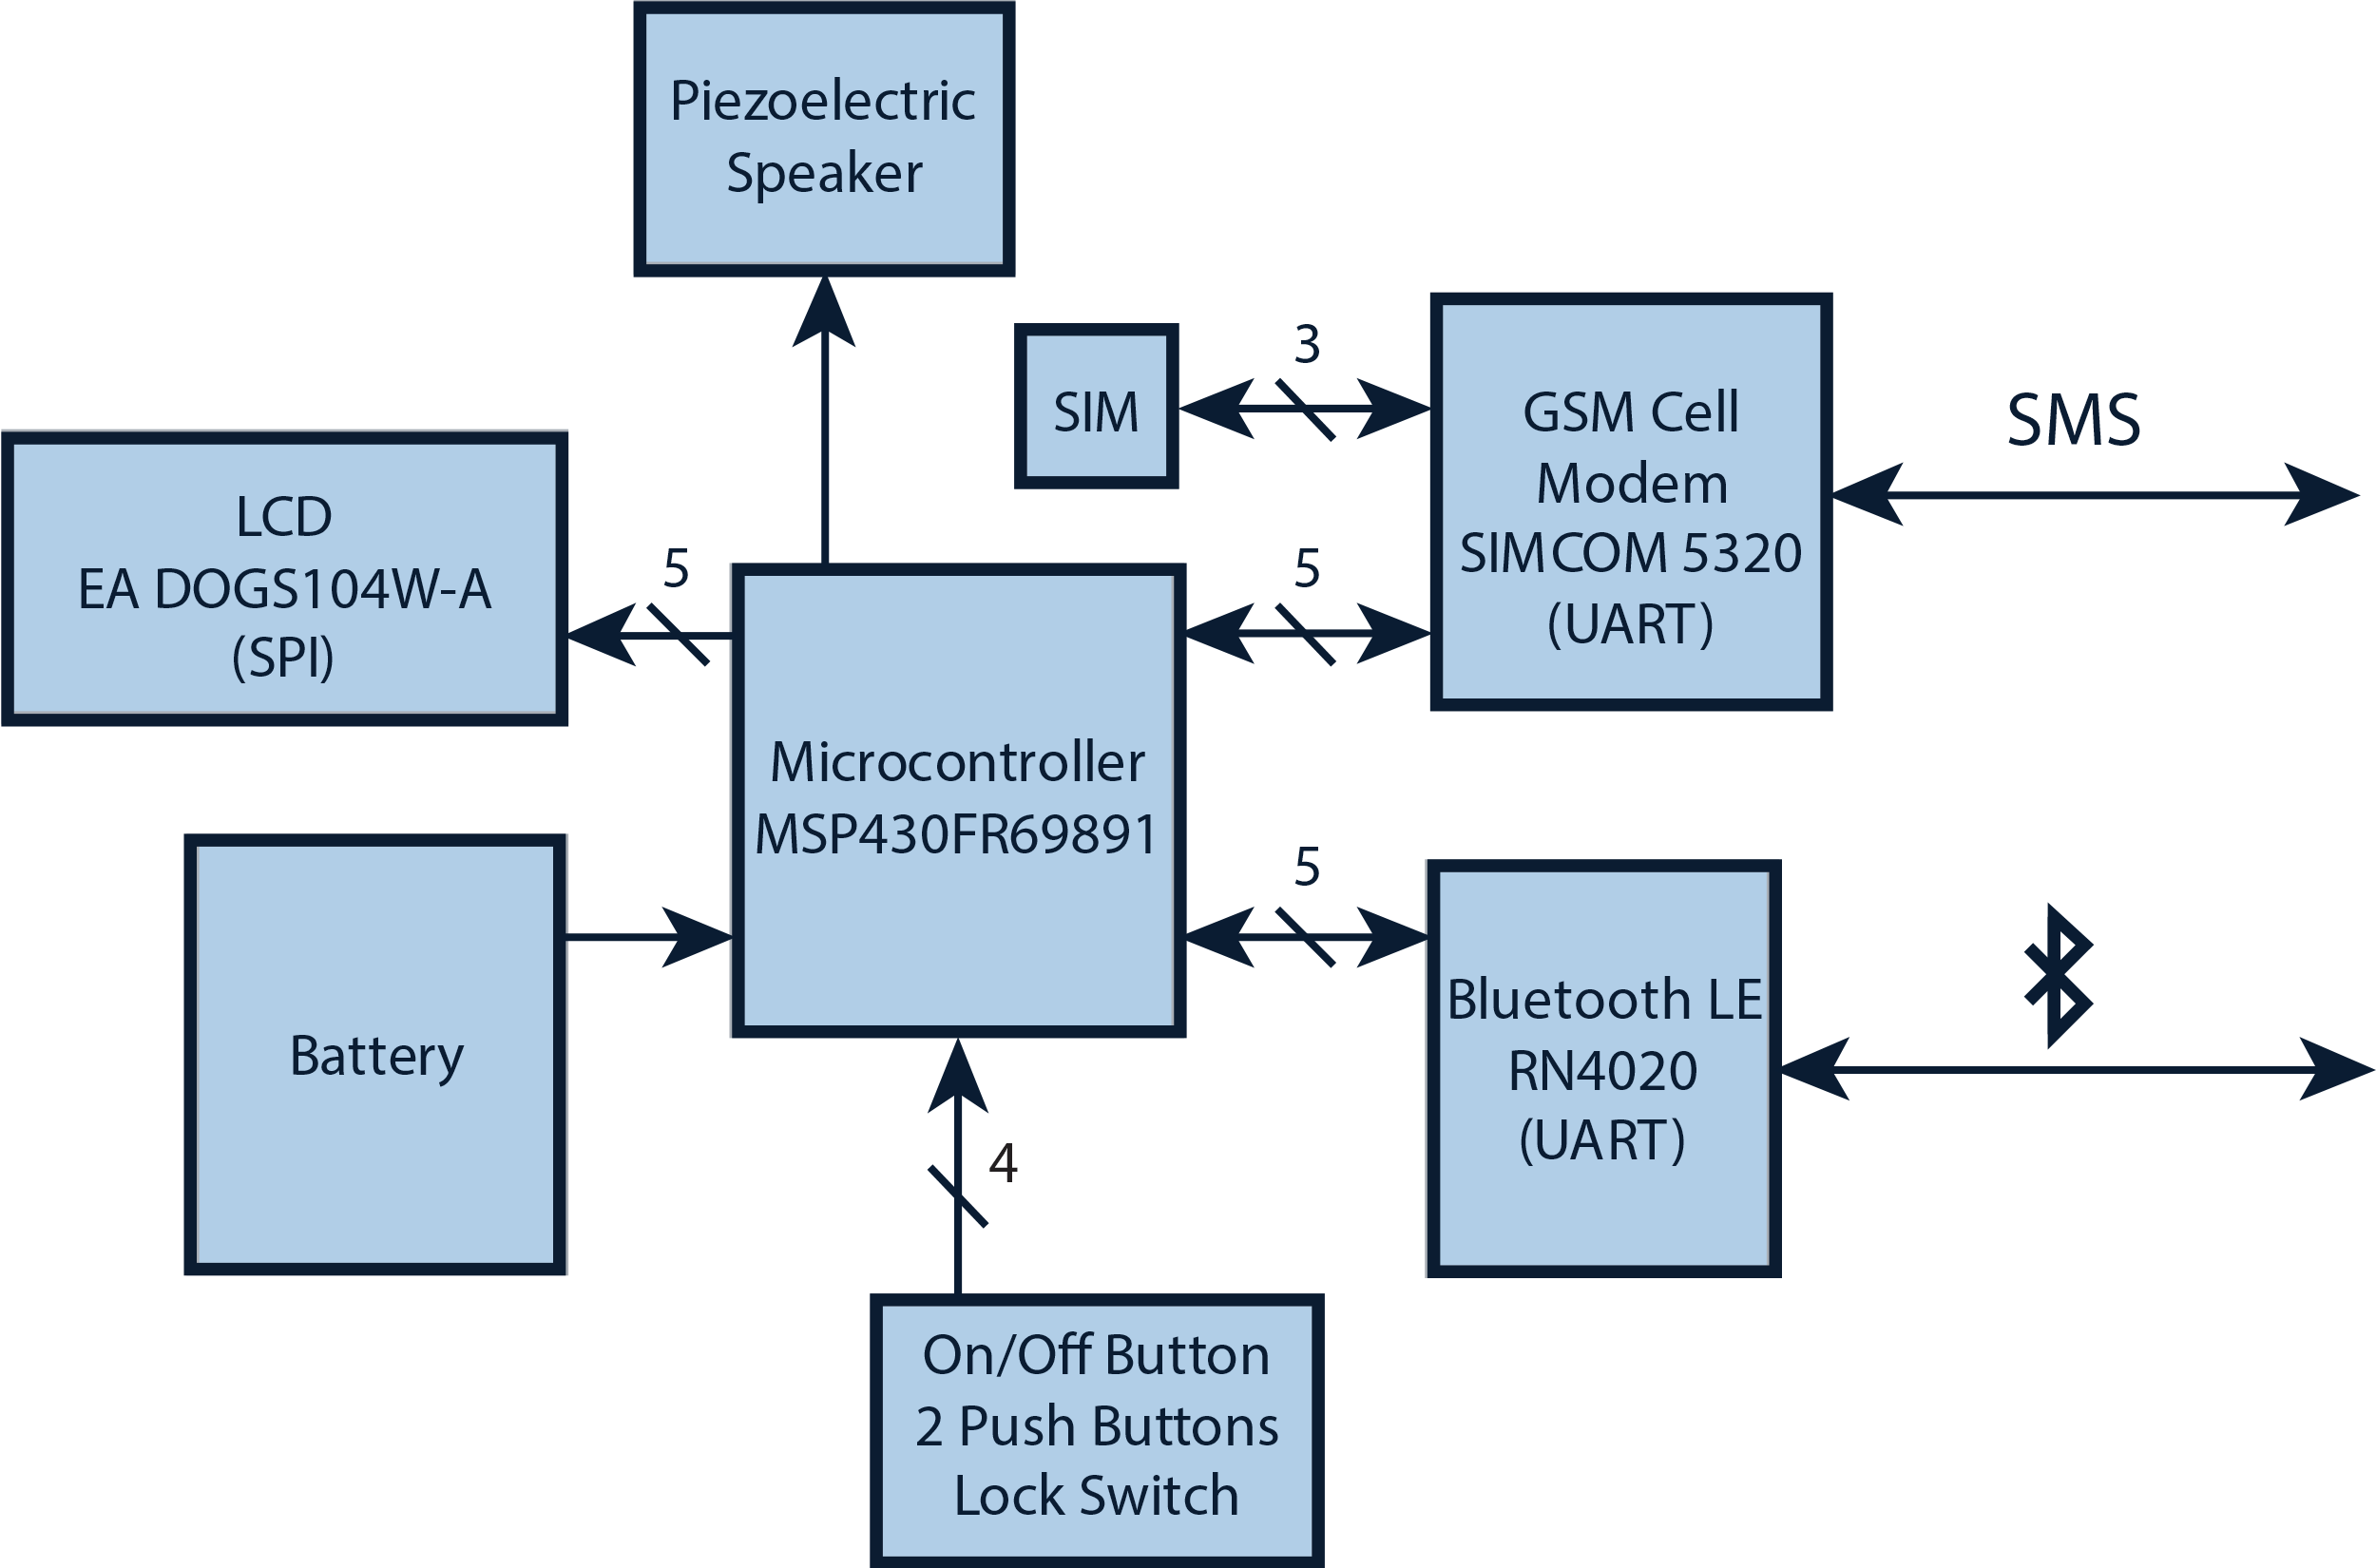
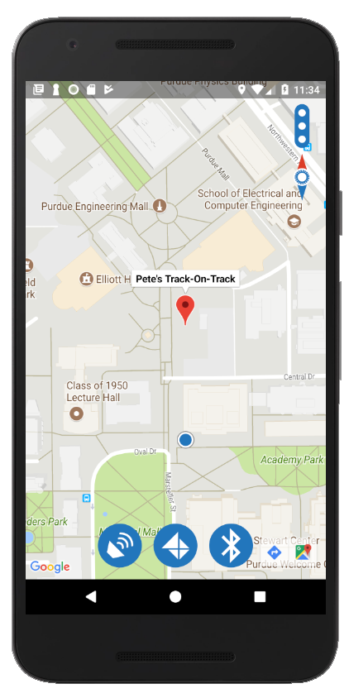
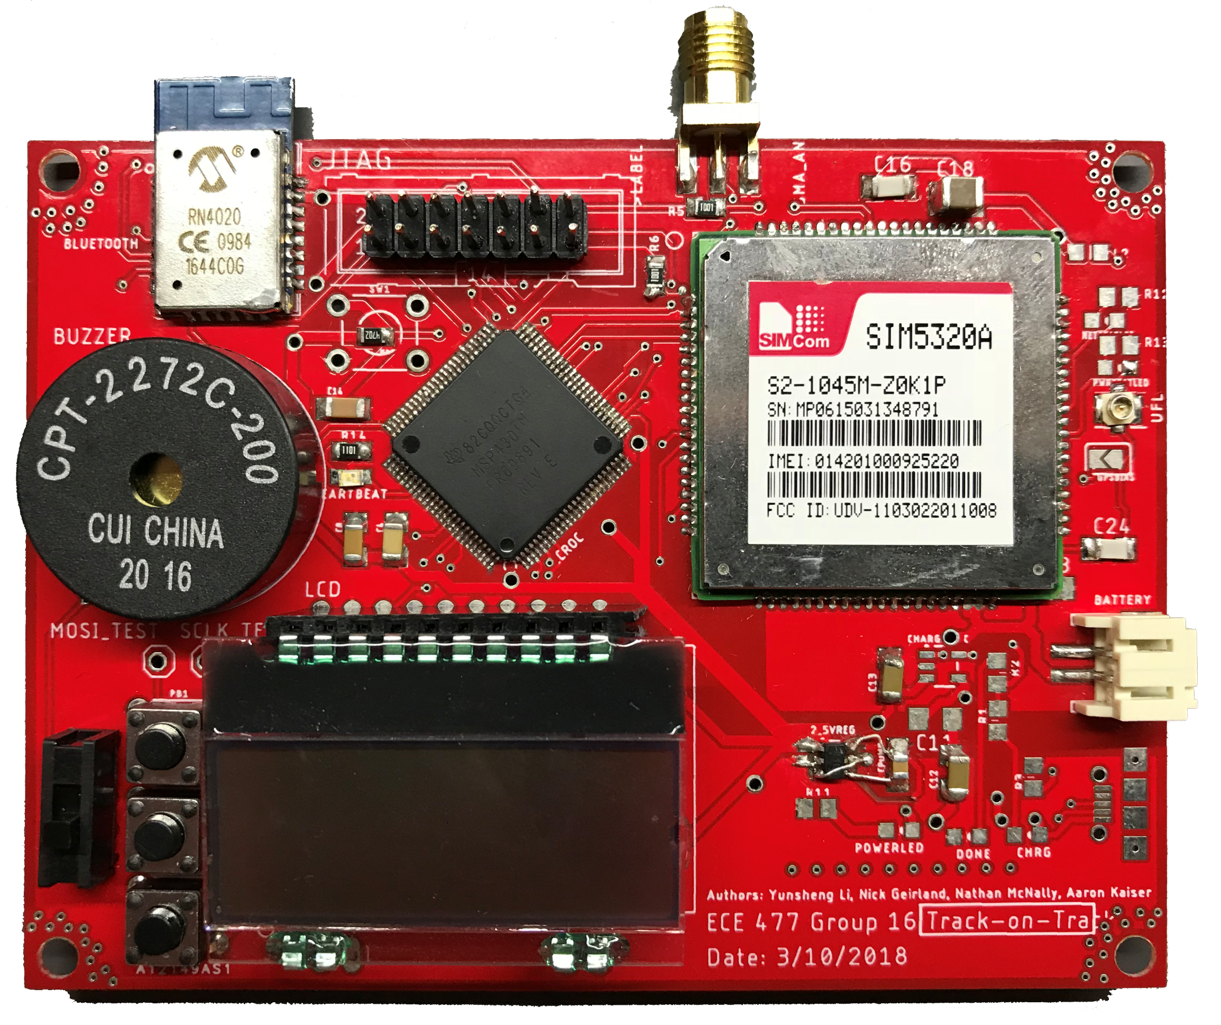
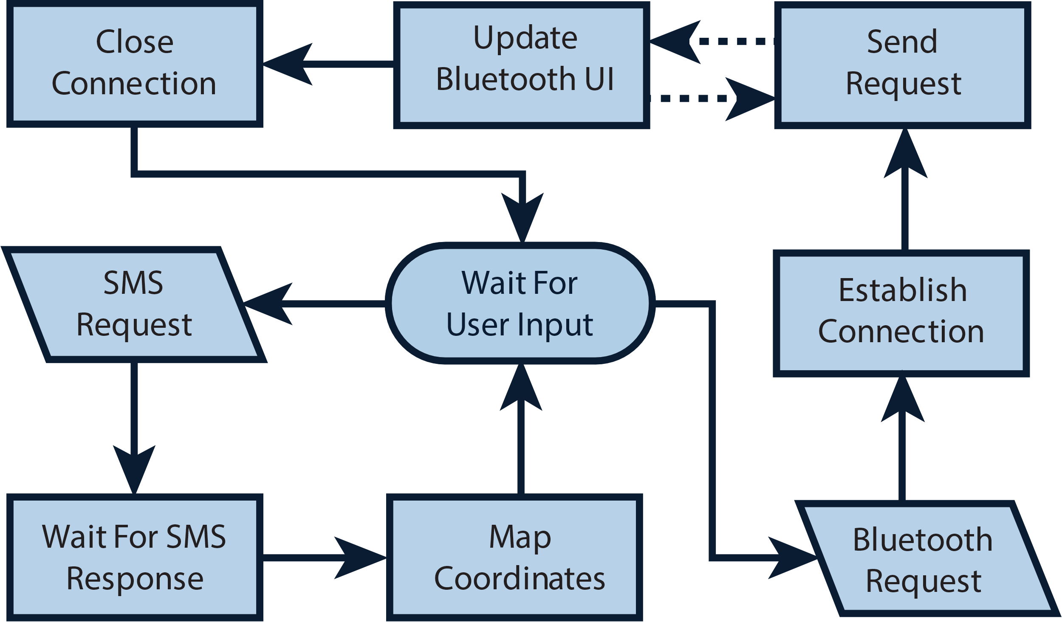

ECE 477 Digital Systems Senior Design Project − Spring 2018
Team 16: Track-On-Track
Nicholas Geirland, Nathan McNally, Yunsheng Li, Aaron Kaiser
Overview
Hardware
Software
Track-on-Track is a device designed to transmit its location to the user via SMS messages and relative distance through Bluetooth. Additionally, the device contains a speaker that is used to locate the device audibly. The project also includes a smartphone application that is the primary means of communicating with the user. The purpose of the device is to locate lost or stolen bags, luggage, or other baggage which may contain valuables. Designed for frequent travelers or those concerned with losing valuables, Track-On-Track will reduce the time it takes to locate lost or stolen bags. During the design process, the device’s small form factor and long battery life were implemented with high importance.
Digijock(ette)-Strength Digital System DesignTM
Transforming Ideas Into Reality

